Slide 1
Coursera Capstone project Battle Of Neighborhoods IBM Applied Data Science
Opening of New Shopping Mall in Banglore,India
By: K Ranga Sai Varshith
Section:B18

Slide 2
Introduction:
A shopping mall is a specially built covered area containing shops
and restaurants which people can walk between, and where cars are
not allowed. In any city Shooping malls are the best way for people
to relax and for shopping in Weekends or Holidays. People can chill
and relax in Shopping malls .Malls are different from bazaars where
the shops are not tiny booths. In Malls each shop has its own space.
Shopping malls consists of shops i.e fashion stores, Theatres and
What not. In Shopping malls people can enjoy relax and they can do
Shopping.

Slide 3
So, the shopping mall should be located in the centre of
city or the place with good neighborhoods. Opening shopping malls
should make developers to earn their consistent rental income.
Literally, the location of Shopping mall plays a crucial role in deter-
Ming whether it is success or not. So, after the great scrutiny of
Neighborhoods the location of Shopping mall should be decided.

Slide 4
Business Problem:
The Ultimate aim of this Capstone is to select the best Locations in
the city of Banglore, India to open a new Shopping mall.
Using the Data science methodology and Machine learning techniques like
Clustering K-means .
The main aim of this capstone is to answer the Business question is:
If the some property Developer wants to build a shopping mall in the City of
Banglore, India, where would you suggest to open it?

Slide 5
Data Required:
List of Neighborhoods in Banglore,India. This defines the scope of
Project which is confined to the city of Banglore, this city is the third
Most populated city in India.
Latitude and Longitude from geopy which is used to get the venues
and plot in the Map.
Venues or venue data which is used in to perform clustering of the
neighborhoods.
Sources of data:
Wikipedia page of neighborhoods.
(https://en.wikipedia.org/wiki/Category:Neighbourhoods_in_Bangalore)
Geocoder Package for Latitude and Lonhitude.
Four Square Api for venue data.

Slide 6
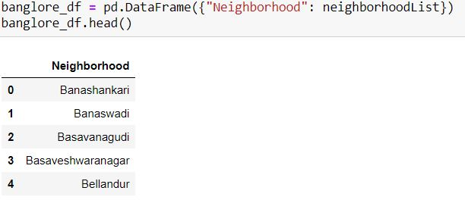
Methodology:
First we need to get the neighborhoods of Banglore from the Wikipedia page: (https://en.wikipedia.org/wiki/Category:Neighbourhoods_in_Bangalore)
Then we have to retrive the list of neighborhoods using requests and Beautiful soup methods.
These are just the names of neighborhoods we have to retrieve the geographical coordinates of the locations using the geopy package which is useful to convert address into latitude and longitude.

Slide 7
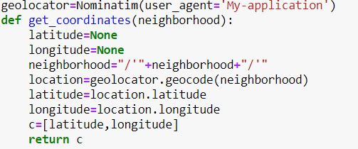
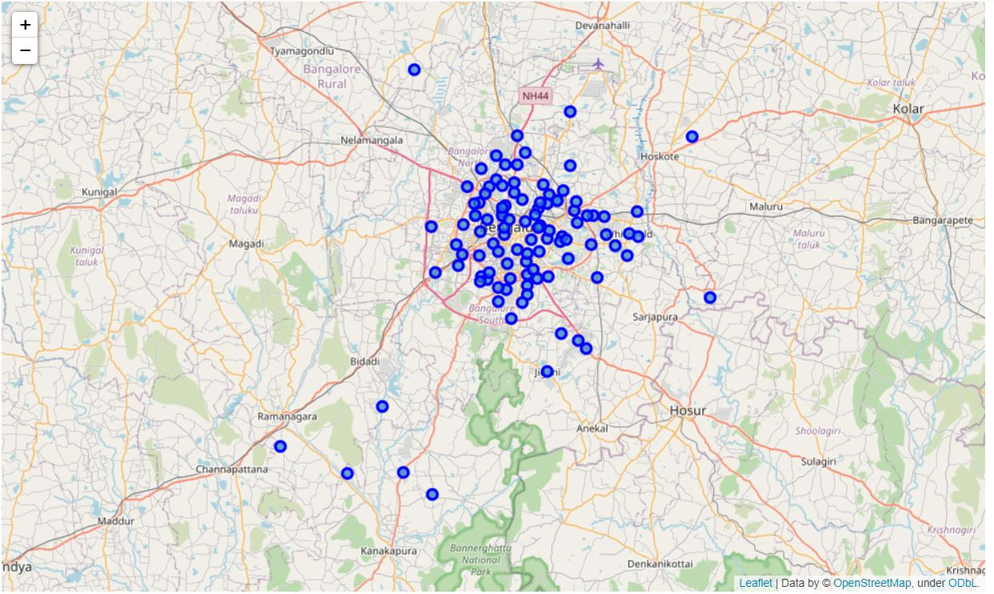
Map of geographical Coordinates:

Slide 8
Using the geographical coordinates and the folium package we have to visualize them in folium maps. FourSquare Api:
Using the four square UPI client id and client server we had to get the top 100 venues of radius 500 metres.
We need to register a Foursquare Developer Account in order to obtain the Foursquare ID and Foursquare secret key.
We then make API calls to Foursquare passing in the geographical coordinates of the neighborhoods in a Python loop. Foursquare will return the venue data in JSON format and we will extract the venue name, venue category, venue latitude and longitude. With the data, we can check how many venues were returned for each neighborhood and examine how many unique categories can be curated from all the returned venues.
Then, we will analyze each neighborhood by grouping the rows by neighborhood and taking the mean of the frequency of occurrence of each venue category. By doing so, we are also preparing the data for use in clustering. Since we are analzsing the “Shopping Mall” data, we will filter the “Shopping Mall” as venue category for the neighborhoods.

Slide 9
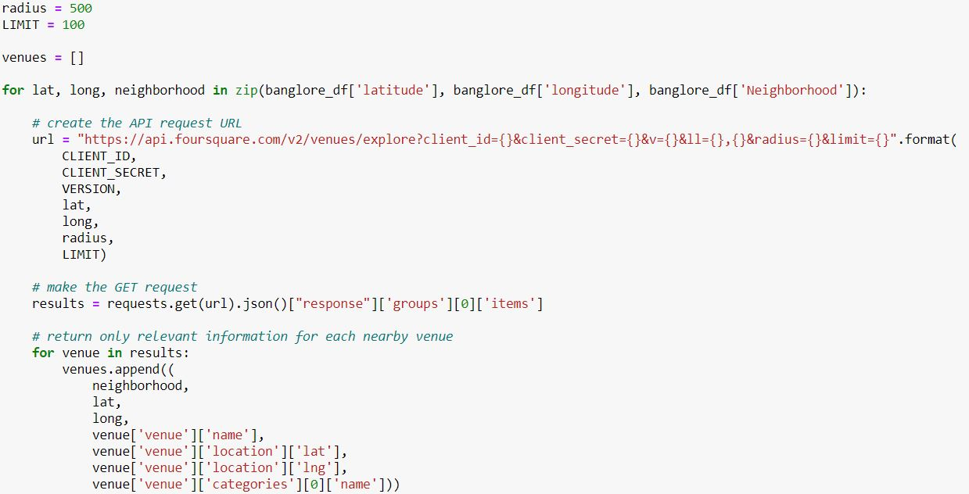

Slide 10
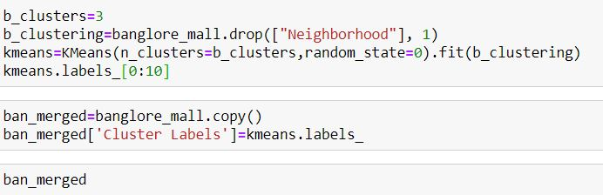
Cluster Neighborhoods:
Then using the K-Means Clustering identifies k number of centroids, and then allocates every data point to the nearest cluster, while keeping the centroids as small as possible.
We will cluster the neighborhoods into 3 clusters based on their frequency of occurence of the shopping mall in Neighborhoods.

Slide 11
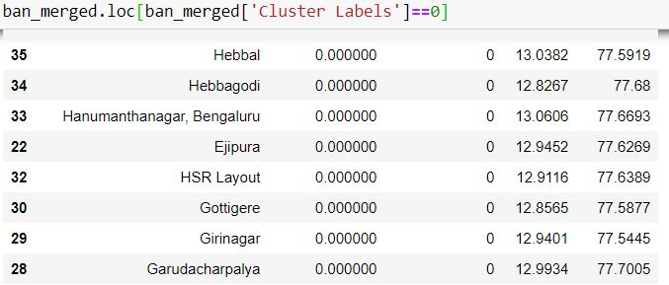
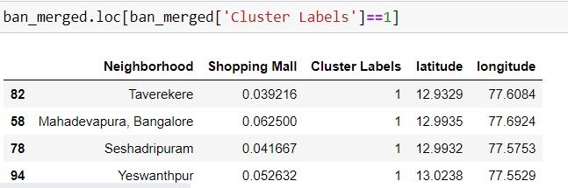
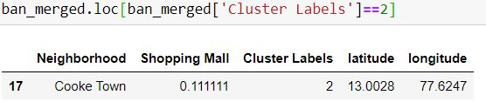
Examine Clusters:
Cluster-0:
Cluster-1:
Cluster-2:

Slide 12
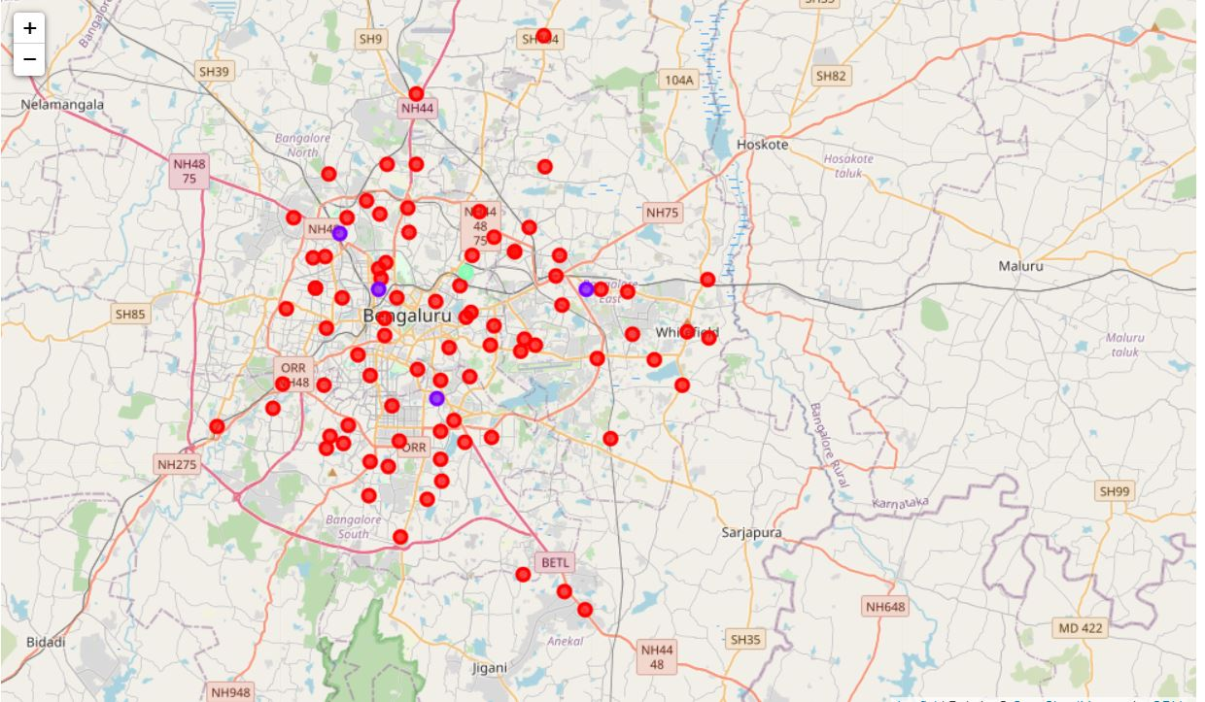
Results: 0-Red 1-Blue 2-Green
Cluster 0: Neighborhoods with moderate number of shopping malls
Cluster 1: Neighborhoods with low number to no existence of shopping malls
Cluster 2: Neighborhoods with high concentration of shopping malls

Slide 13
Discussions:
As we seen or observed in the examine of clusters that most of the shopping malls are situated in the places of cluster 2 and moderate number in cluster1. But there were no shopping malls in the places of cluster0.
So, it is advisible for the developers or Investors that malls should be located either in cluster0 places with no competition or cluster 1 places with moderate competition.
It is not suggestible to open the shopping mall in cluster0 areas or neighborhoods.
Recommendations:
Here we considered only the frequency of occurance of Shopping malls but there were other factors other than this such as Population etc;

Slide 14
Conclusion:
In this capstone we have gone long through i.e extracting a data from webpage using requests and beautiful soup.
Foursquare api requesting for geographical coordinates and mapping them.
Analyzing the neighbourhood and examining the clusters for the recommendation of best places to Investors to open new Shopping mall.
The findings of this project will help the relevant stakeholders to capitalize on the opportunities on high potential locations while avoiding overcrowded areas in their decisions to open a new shopping mall.

